Slide 1

Evaluation of Various Sensing Modalities for Accurate Measurement of Neck Flexion Angle during Thyroid and Ear Surgery
Seminar Presentation
Team Member : Zhen Hu, Hanqing Duan
Mentor: Dr. Russell Taylor, Dr. Deepa Galaiya

Slide 2
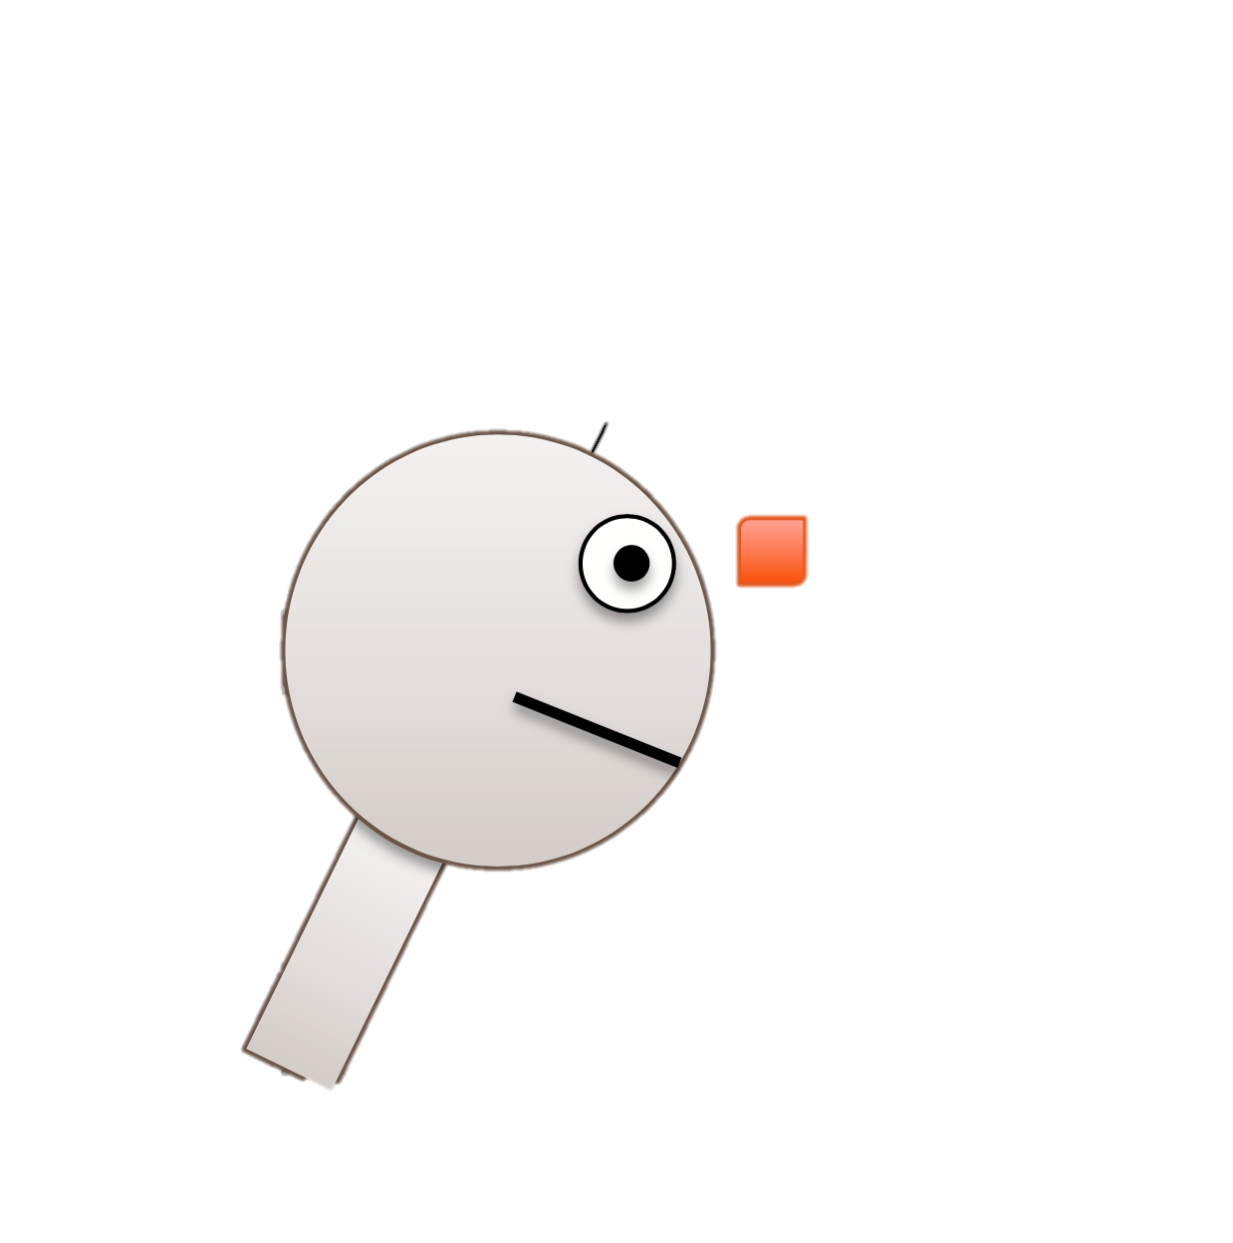
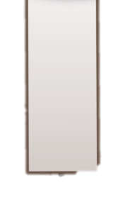


Project Summary
A6
Goal: Accurate Measurement of Neck Flexion Angle during Thyroid and Ear Surgery by using IMUs
IMU: Inertial measurement unit
Accurate: Calibrate IMUs’ pitch angle against EM tracker
Neck Flexion Angle: extract pitch angle between two IMUs
Surgeries: Analyze neck flexion angle changes in real surgical scenarios if possible
$$θ$$
1A
Figure Edit from: https://stanford.edu/class/ee267/lectures/lecture10.pdf

Slide 3
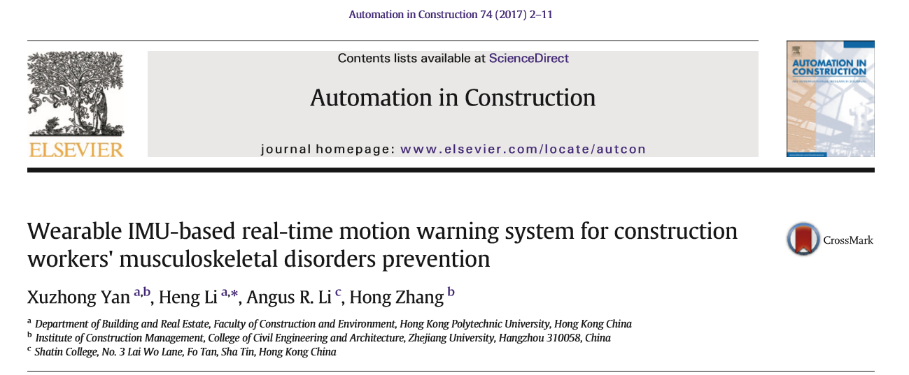
Paper Selection

Slide 4
Selection Reason
High Relevance
Similar angle measurement system (Two IMUs)
Useful angle calculation formula (Two Quaternions)
Good Idea
Entire wearable motion warning system (Real-time feedback)

Slide 5
Problem Statement & Background
In the construction industry, work-related musculoskeletal disorders (WMSDs) around lower back and neck are prevalent.
To avoid this kind of pain, time spent in insecure operational postures should be proactively prevented.
Yan, Xuzhong, et al. "Wearable IMU-based real-time motion warning system for construction workers' musculoskeletal disorders prevention." Automation in Construction 74 (2017): 2-11.

Slide 6
Key Result & Significance
Authors developed a real-time motion warning personal protective equipment (PPE)
Enables workers' self-awareness and self-management of ergonomically hazardous operational pattern for the prevention of WMSDs
Wearable Inertial Measurement Units (WIMUs)
Without disturbance and distraction in operations
Yan, Xuzhong, et al. "Wearable IMU-based real-time motion warning system for construction workers' musculoskeletal disorders prevention." Automation in Construction 74 (2017): 2-11.

Slide 7
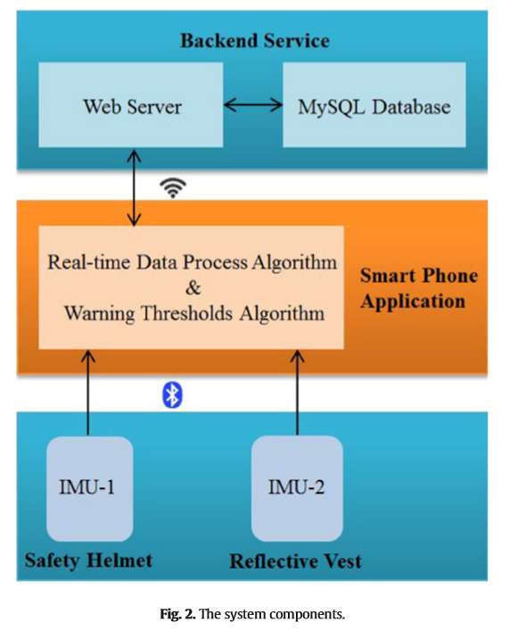
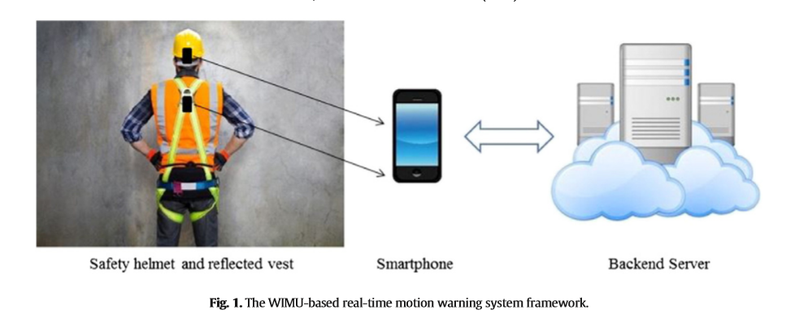
Method - system
Yan, Xuzhong, et al. "Wearable IMU-based real-time motion warning system for construction workers' musculoskeletal disorders prevention." Automation in Construction 74 (2017): 2-11.

Slide 8

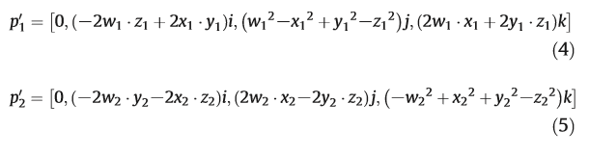
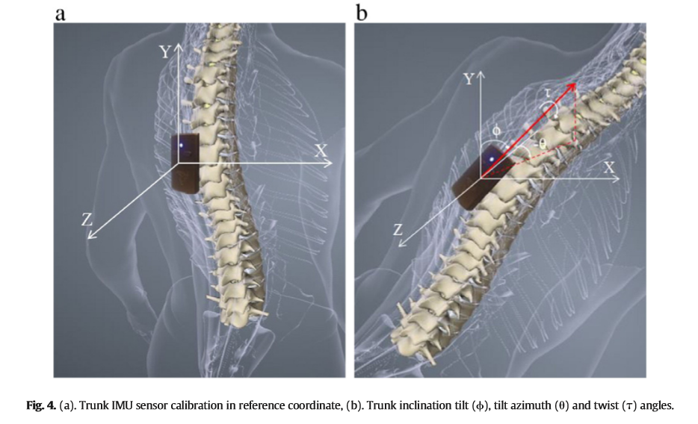
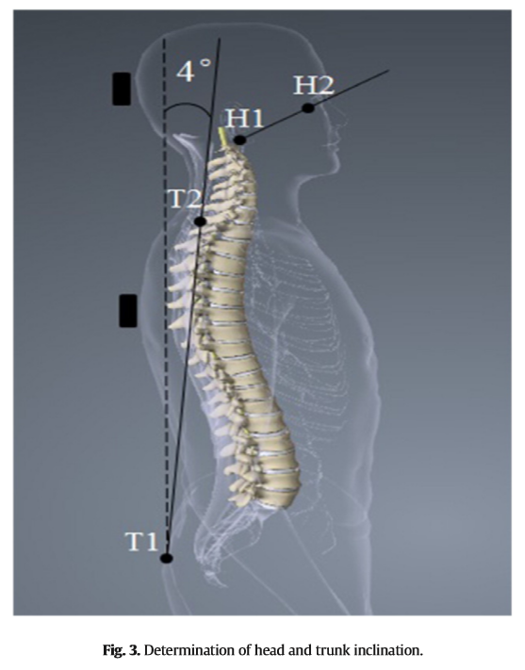



Method - data analysis
Yan, Xuzhong, et al. "Wearable IMU-based real-time motion warning system for construction workers' musculoskeletal disorders prevention." Automation in Construction 74 (2017): 2-11.

Slide 9
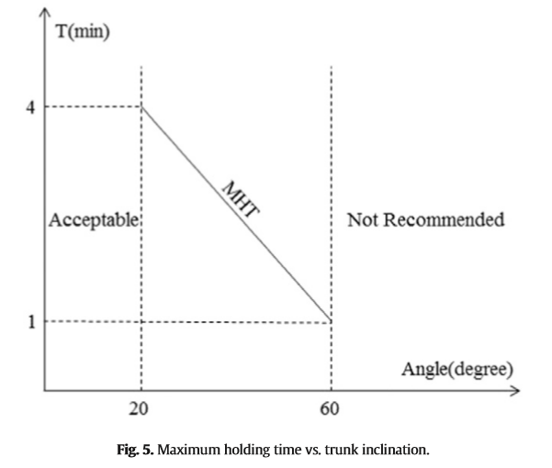

Method - warning threshold
If t > MHT(A), warning!
Yan, Xuzhong, et al. "Wearable IMU-based real-time motion warning system for construction workers' musculoskeletal disorders prevention." Automation in Construction 74 (2017): 2-11.

Slide 10
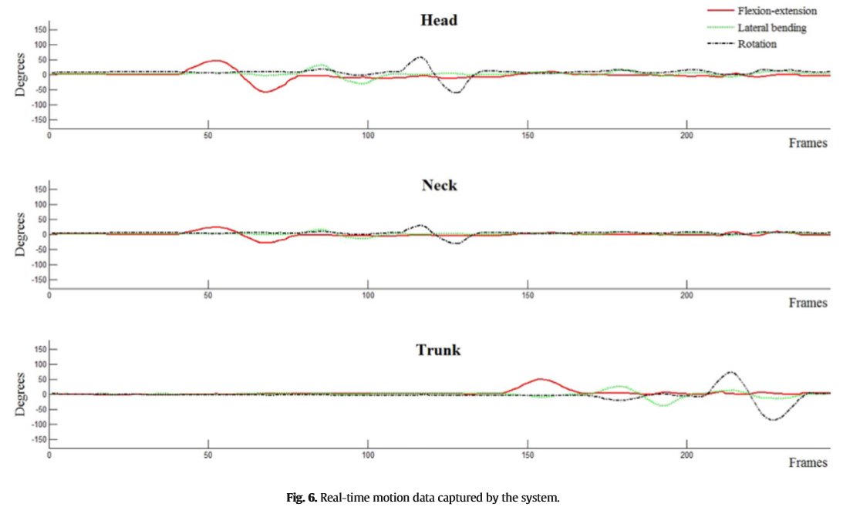
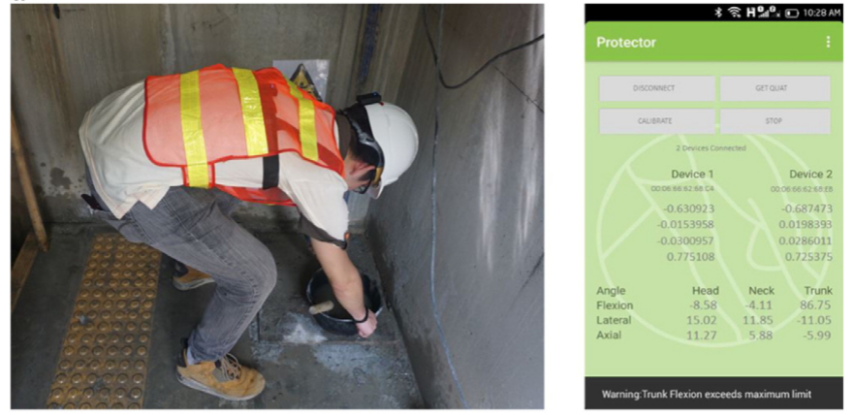
Experiment
Yan, Xuzhong, et al. "Wearable IMU-based real-time motion warning system for construction workers' musculoskeletal disorders prevention." Automation in Construction 74 (2017): 2-11.

Slide 11
Conclusion & Further Work
Meaningful, useful, cost-effective, suitable for construction operations.
Authors’ further work:
IMU sensors need to recharge after a nearly six-hour service
adding a solar charger into each unit
Accuracy of the captured body segments by the WIMU sensors may vary upon different people due to different skeletal structures and body sizes
develop algorithms
Yan, Xuzhong, et al. "Wearable IMU-based real-time motion warning system for construction workers' musculoskeletal disorders prevention." Automation in Construction 74 (2017): 2-11.

Slide 12
Paper Assessment
Pros:
Real-time warning system
Clear mathematical formula
Collect data in backend server
Cons:
No details about IMU’s calibration
No details about what analysis backend server could do

Slide 13
Back to our project
Angle between two Quaternions calculation method is used in our calibration process.
Motion warning system could be used to notice surgeons' wrong position and to teach young surgeons with right operating postures in time.

Slide 14
Thanks!

